Slide 1
Client Name Energy & Water Assessment August 27, 2014
Notes:
To Do List:
Modify Name of nonprofit
Modify date
Discussion Points:
Grants to Green goals:
Reduce environmental impact of facilities by savings energy and water
Cut operations costs
Use money saved to support nonprofit mission

Slide 2
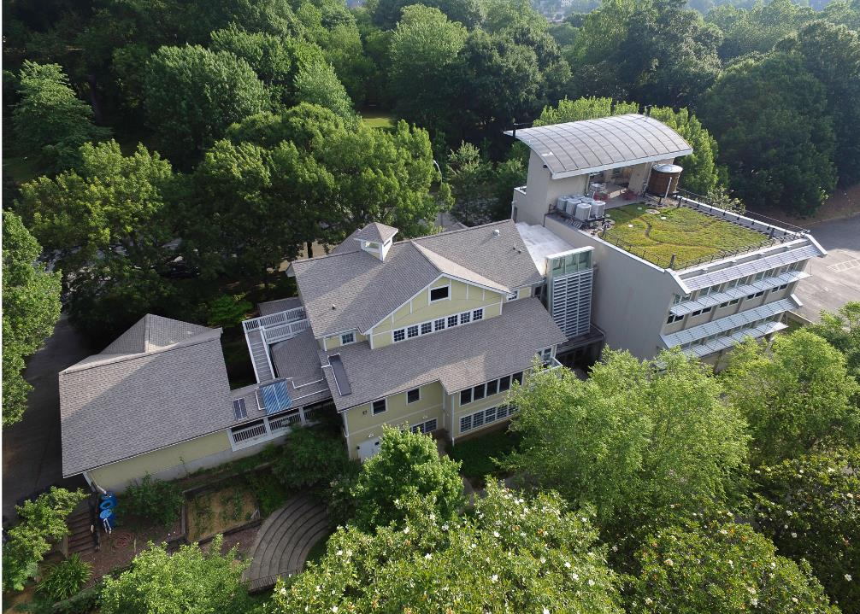
For over 35 years, Southface has promoted sustainable homes, workplaces, and communities throughout the Southeast.
Notes:
To Do List:
Discussion Points:
Southface’s work

Slide 3
Assessment Process
Notes:
To Do List:
1. Add photo of assessment site visit conducted at facility.
Discussion Points:
Discuss assessment process: Southface evaluates significant energy and water consuming systems
Mention nonprofit staff who assisted during assessment

Slide 4
What does it take to operate?
Annually
$19,000
Monthly
$1,500
$/Sq. Ft.
$1.50
Notes:
To Do List:
Modify Annual Operations Costs (Total utility bills)
Modify Average Monthly Operations Costs (average monthly utility bills)
Modify Annual Cost per Square Foot (total utility bills/total square feet)
Discussion Points:
Recap what it currently takes to operate the facility from a utility standpoint (energy & water)

Slide 5
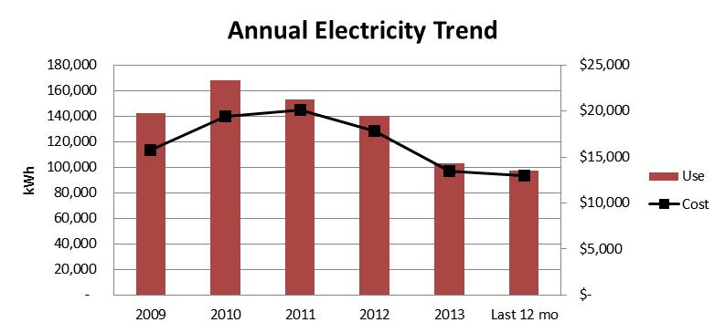
What’s our electricity history?
32% reduction since 2009!
Notes:
To Do List:
Insert annual electricity trend graph
Insert % reduction/increase in utilities since X Year
Discussion Points:
Big Picture: how does electricity compare to the rest of the utilities?
- e.g. ECC’s electricity is 68% of total utility costs, $1/sf of the total $1.50 /sf for utilities
Compare to the last year and 12 months of use
Identify anomalies
Acknowledge reduction through previous efforts
If reduction in electricity: acknowledge reduction through previous efforts
If increase in electricity: discuss potential to improve

Slide 6
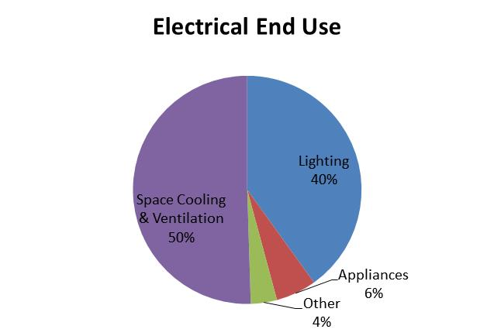
Where does it all go?
Notes:
To Do List:
Insert electricity end use graph
Discussion Points:
Emphasize largest electricity consumers
e.g. Space Cooling & Ventilation, Lighting
2. Discuss how this compares to a comparable facility (is this normal?)

Slide 7
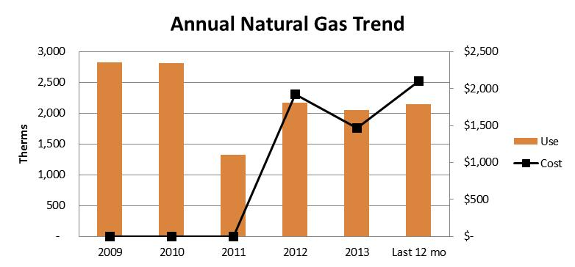
What’s our gas history?
24% reduction since 2009!
Notes:
To Do List:
Insert annual natural gas trend graph
Insert % reduction/increase in utilities since X Year
Discussion Points:
Big Picture: how does natural gas compare to the rest of the utilities?
e.g. ECC’s natural gas is 11% of utility costs, $0.15/sf of the total $1.50 /sf for utilities
Identify anomalies
Compare to the last year and 12 months of use
Acknowledge reduction through previous efforts
If reduction in natural gas: acknowledge reduction through previous efforts
If increase in natural gas: discuss potential to improve

Slide 8
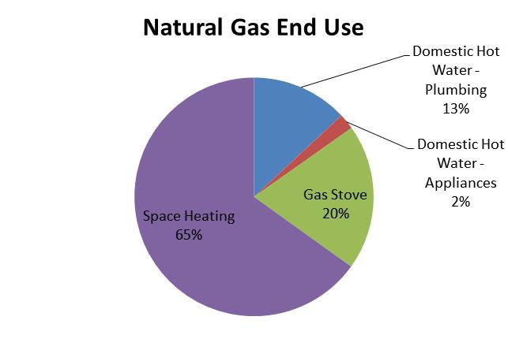
Where does it all go?
Notes:
To Do List:
Insert natural gas end use graph
Discussion Points:
Emphasize largest natural gas consumers
e.g. Space heating, DHW
2. Discuss how this compares to a comparable facility (is this normal?)

Slide 9
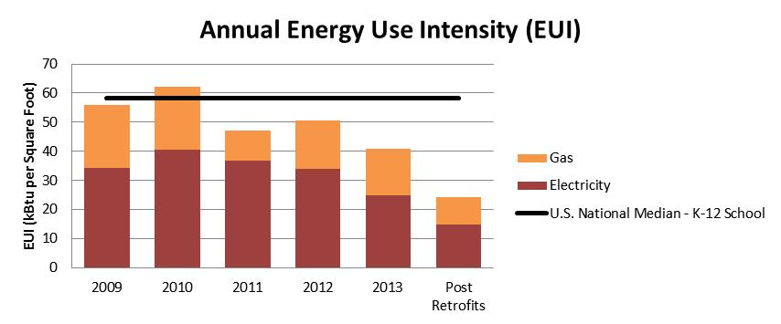
Where do we rank?
Potential to save up to 40%
Notes:
To Do List:
Insert Annual Energy Use Intensity (EUI) graph
Insert % potential to save
Discussion Points:
How does the facility rank against the national median facility of its type today?
How does the facility rank against the national median facility of its type if all projects recommended are implemented?
Acknowledge reduction through previous efforts
Acknowledge potential % reduction through implementation of recommended projects

Slide 10
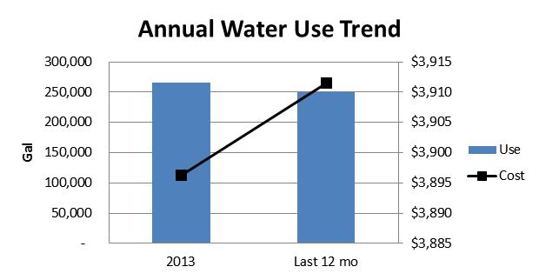
What’s our water history?
6% reduction since 2013!
Notes:
To Do List:
Insert annual water trend graph
Insert % reduction/increase in utilities since X Year
Discussion Points:
Big Picture: how does water compare to the rest of the utilities?
e.g. ECC’s water is 21% of utility costs, $0.30/sf of the total $1.50 /sf for utilities
Identify anomalies
Compare to the last year and 12 months of use
Acknowledge reduction through previous efforts
If reduction in water: acknowledge reduction through previous efforts
If increase in water: discuss potential to improve

Slide 11
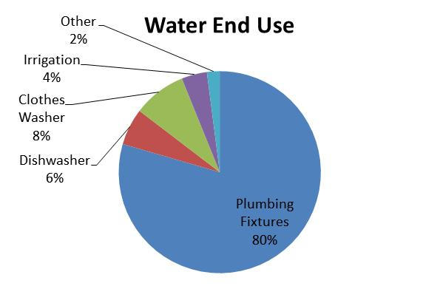
Where does it all go?
Notes:
To Do List:
Insert water end use graph
Discussion Points:
Emphasize largest water consumers
e.g. Plumbing Fixtures, appliances
2. Discuss how this compares to a comparable facility (is this normal?)

Slide 12
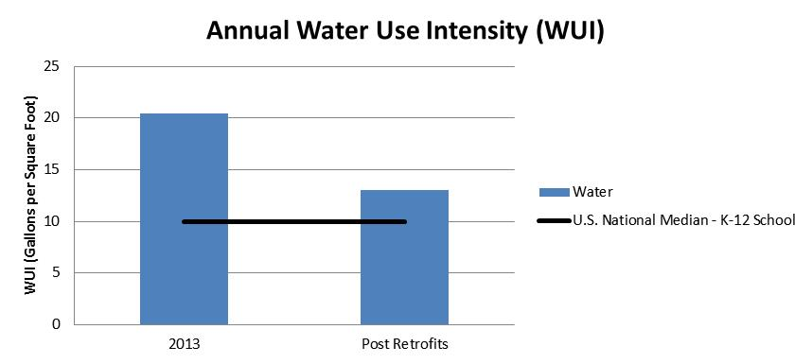
Where do we rank?
Potential to save up to 30%
Notes:
To Do List:
Insert Annual Water Use Intensity (WUI) graph
Insert % potential to save
Discussion Points:
How does the facility rank against the national median facility of its type today?
How does the facility rank against the national median facility of its type if all projects recommended are implemented?
Acknowledge reduction through previous efforts
Acknowledge potential % reduction through implementation of recommended projects

Slide 13
The Results
Notes:
To Do List:
Insert snapshot of Final Presentation Handout, or a tabular summary of projects (and alternative projects).
Discussion Points:
Mention that this handout is available in front of them (print out for presentation)
Discuss the layout of the table: meaning of columns
- Projects are organized from shortest to longest payback period
Identify projects to be discussed in this presentation (if not all of them)

Slide 14
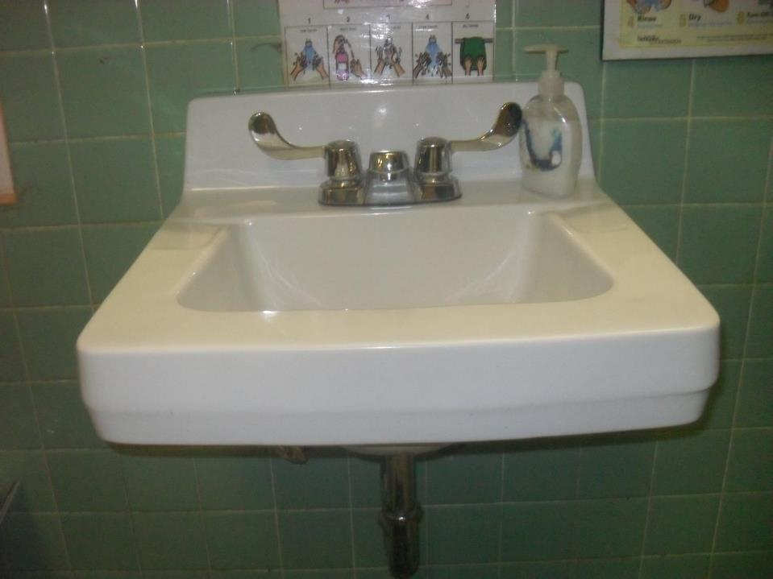
Water Efficient Plumbing Fixtures
Notes:
To Do List:
Insert title of proposed project
Insert picture of existing system for project under discussion
Insert brief description of existing system (if necessary)
Discussion Points:
Explain current use of systems (inefficiency, age, etc.)
Discuss potential opportunity

Slide 15
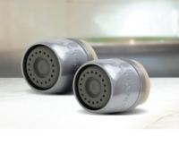
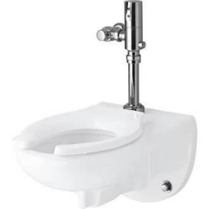
Water Efficient Plumbing Fixtures
High Efficiency
Staff Water Closets,
Motion Sensor Faucets, Kitchen Pre-Rinse Sprayer
Savings
$1,000
Cost with G2G
$4,800
Return on Investment
4.4 Years
…and while you wait for funding, simply replace the aerators for a couple bucks!
Notes:
To Do List:
Insert title of proposed project
Insert picture(s) of proposed system for project under discussion
Insert brief description of proposed project (top)
Insert estimated savings, cost with G2G funding, and ROI (bottom)
Discussion Points:
Explain current use of systems
Discuss potential impact of proposed project to operation costs, comfort, infrastructure durability, etc.
Template Picture: Motion sensor faucet & high-efficiency water closet

Slide 16
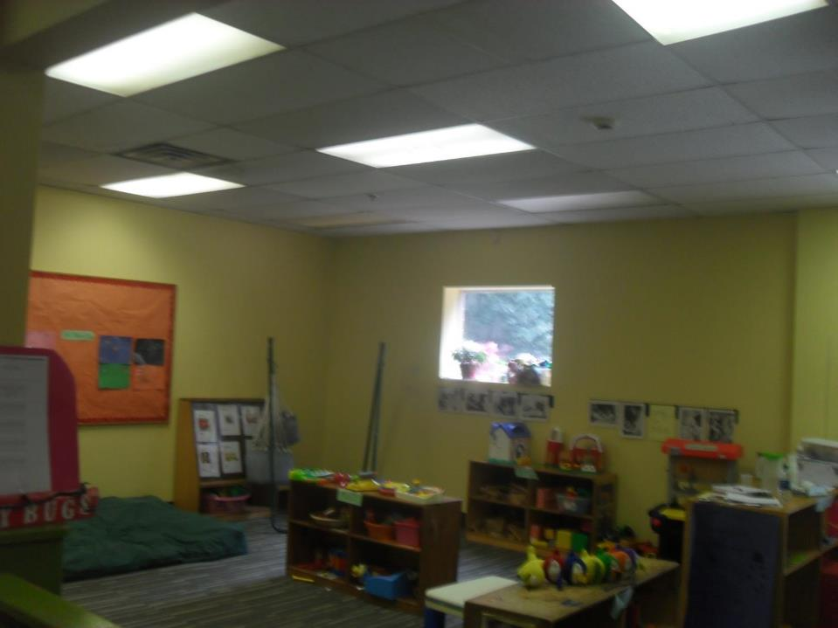
LED Lighting & Controls
Existing lighting
banned from
manufacture in the US
Poor light quality
No controls to optimize use and fixture durability
Notes:
To Do List:
Insert title of proposed project
Insert picture of existing system for project under discussion
Insert brief description of existing system (if necessary)
Discussion Points:
Explain current use of systems (inefficiency, age, etc.)
Discuss potential opportunity

Slide 17
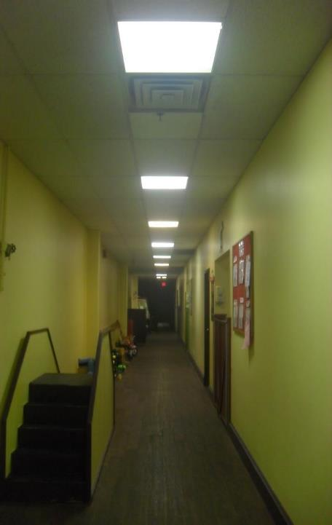
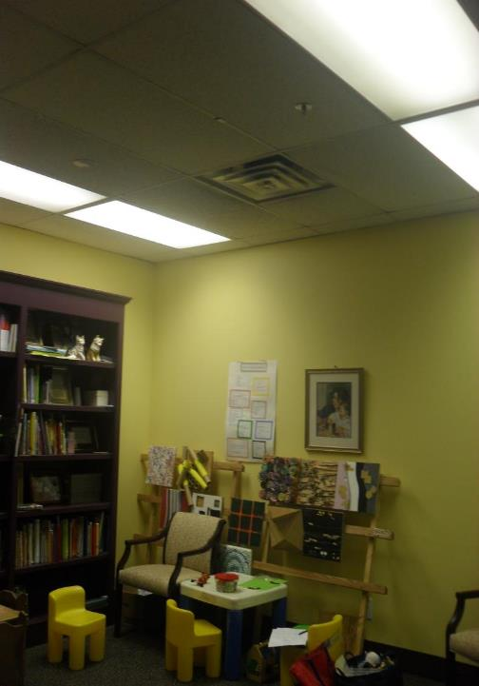
LED Lighting & Controls
Notes:
Previous slide continued…

Slide 18
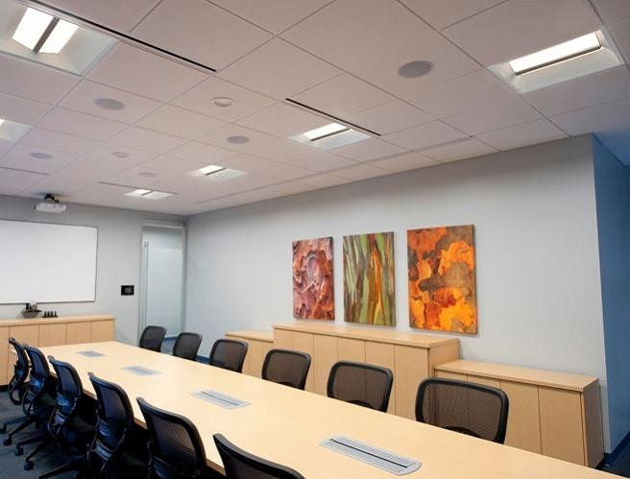
LED Lighting & Controls
LED Lighting throughout
(Interior & Exterior)
with Vacancy or Photocell Controls
Savings
$3,800
Cost with G2G
$49,000
Return on Investment
6.4 Years
Notes:
To Do List:
Insert title of proposed project
Insert picture(s) of proposed system for project under discussion
Insert brief description of proposed project (top)
Insert estimated savings, cost with G2G funding, and ROI (bottom)
Discussion Points:
Explain current use of systems
Discuss potential impact of proposed project to operation costs, comfort, infrastructure durability, etc.
Template Picture: LED meeting space

Slide 19
Project Recap
Estimated Energy Savings
40%
Estimated Water Savings
30%
Estimated Savings
$7,500
Estimated Project Budget
$187,500
Return on Investment
>20 Years
Notes:
To Do List:
Insert picture of nonprofit logo
Insert estimated energy savings, %
Insert estimated water savings, %
Insert estimated annual savings, $
Insert estimated project budget, $
Insert return on investment, Years
Discussion Points:
Explain financial analysis seen here does not quantify maintenance effectiveness, quality, and comfort as a result of the investment.

Slide 20
Project Recap
Estimated Energy Savings
40%
Estimated Water Savings
30%
Estimated Savings
$7,500
Estimated Project Budget
$187,500 $94,000
Return on Investment
>20 Years 12.5 Years
Notes:
To Do List:
Insert estimated project budget if Grants to Green funding is pursued, $
Insert return on investment if Grants to Green funding is pursued, Years
Discussion Points:
Emphasize that cost and return on investment are cut in half through the Grants to Green Implementation Grant.
Mention that project costs are lowered if Georgia Power Rebates are pursued

Slide 21
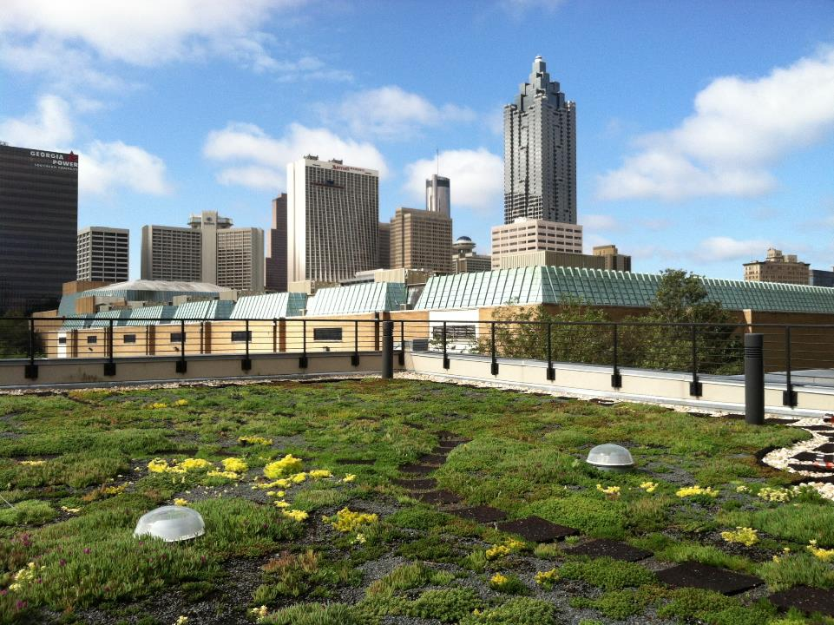
Next Steps
Southface
Submit Final Report to Client
Client
Utility Tracking
Implementation Grant
(early 2015)
Green Champion Convening
(November 20)
Notes:
To Do List:
Modify name of nonprofit
Modify dates/years
Discussion Points:
Next Steps

Slide 22
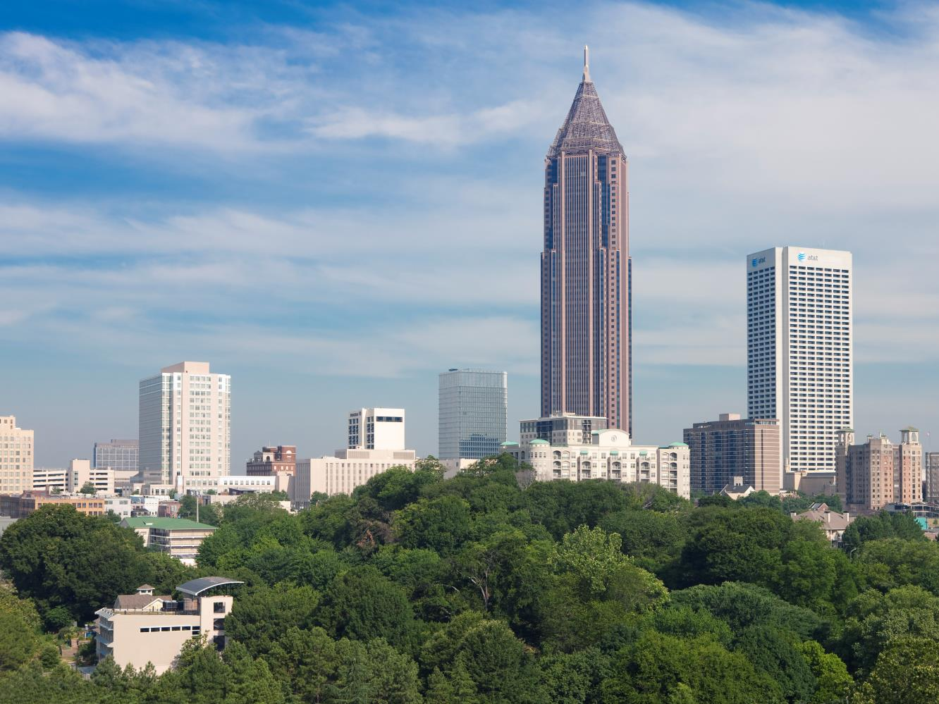
Questions / Comments
Project Assessor Contact Info

